Slide 1
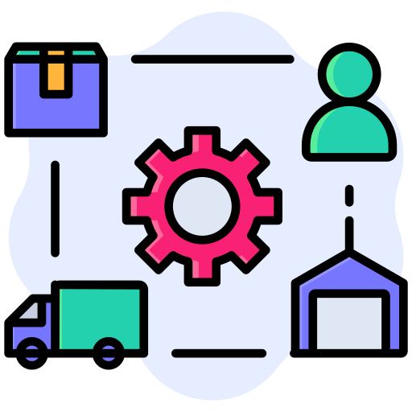
Private Sector Applications: Supply Chain Tracking
By Miguel Ibrahim
Carlos Vallado
Ruben Thienpont
Notes:
Hi, I’m Miguel from group 9 and in today’s presentation we are going to talk about Supply Chain Tracking
So first, how do you define supply chain? Supply chain is the processes involved in the production and the distribution of a commodity. It could be anything from some fruits to a cell phone, but in this presentation, I will be zooming into the food supply chain, because that is one of the complex cases out there – another case is the semiconductor supply chain

Slide 2
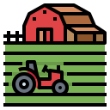

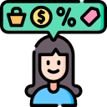
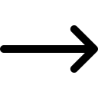
Notes:
In this case we have some carrots going from the farmer to a distributor and then purchased by a customer like you and me
Now technically the food supply chain does not look as simple as it does on this slide It’s actually much more complex than what this slide entails.

Slide 3
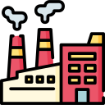
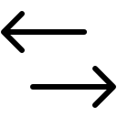
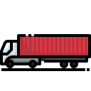
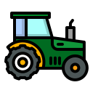
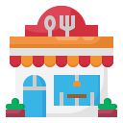
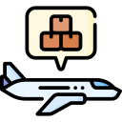
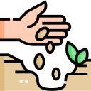
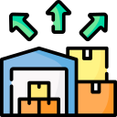
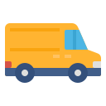
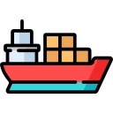

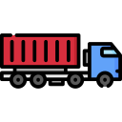
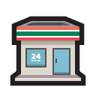

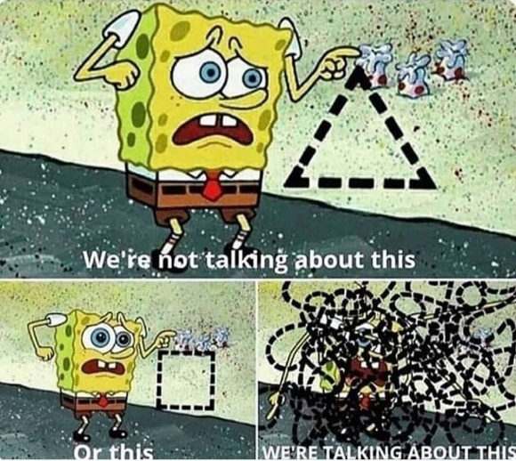
Notes:
Let’s run through an example together to see how complex it can get
First we have seed distributors that distribute seeds to farms, these farms distribute produce to suppliers and suppliers supply items to factories which then are sent to distributors and the distributors distribute them to the restaurants and shops.
And to be honest there are even more hidden layers under this , and you can see this as more of a black box, such as the delivery methods, taxes, laws, monopolies, fraud, it gets chaotic really quickly.
And you can start thinking, what could go wrong?

Slide 4


Provenance
Notes:
Actually many things could go wrong In this example, out poor poor Alice, got sick, and we have no actual reason why she got sick.
And this brings me onto the first issue, the provenance issue, provenance dictates that when something goes wrong in this supply chain, we can always find the origin of this problem by tracing transactions back to the source of that issue.
Well, with traditional supply chains, the process of identifying that alice consumed a dish from a restaurant, and that dish had a parasite that came from the shop, following this path and tracing it back to it originating from the farm.

Slide 5
Provenance
Traceability
Notes:
Another issue to add onto the stack is traceability
The difference between traceability and provenance is that with traceability you want to track that exact item going from point a to point b.
In this example, we want to track that specific item that make Alice sick, which got delivered using truck or a lorry.
The issue with traditional supply chain is that this is somewhat hard to do with just a shared databases, because the customer and all the intermediaries in this graph want to track it as well.

Slide 6
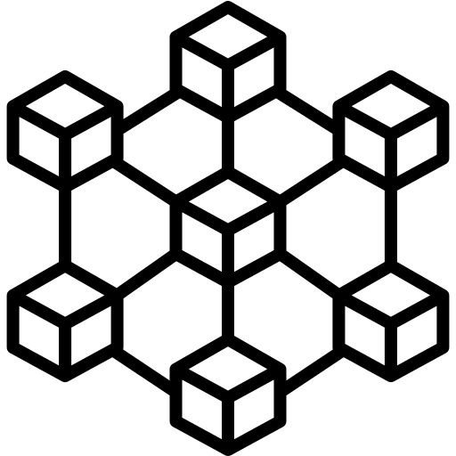
Provenance
Traceability
Transparency
Automation
Notes:
Of course those two issues were two of the main issues when it comes to traditional supply chains, so its also important to mention two more, mainly transparency and automation
Transparency – traditional supply chains lack transparency – as in everyone has localized databases of what is stored and what or how much items got distributed, nothing is shared
Automation – problem now is that it is not automated
And how do you solve these issues you may ask?
Well the main topic of this course is Blockchain, so you can solve these issues using blockchain.
Provenance → Blockchain keeps a ledger of all transactions made so you can follow the issue to its souce
Traceability → Blockchain is a shared ledger that updates quickly so you can easily trace a product going from point A to B
Transparency → Blockchain is transparent as realized throughout the course
Automation → With QR codes on boxes you can integrate blockchain with ERPs and IoT that way when a product arrives to the consumer, payment is released – though smart contracts

Slide 7
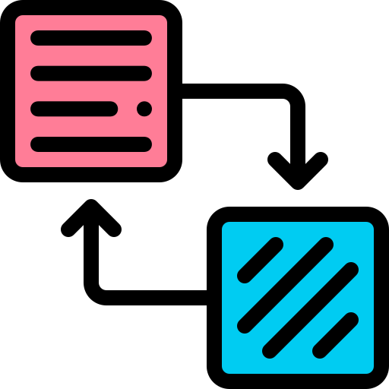

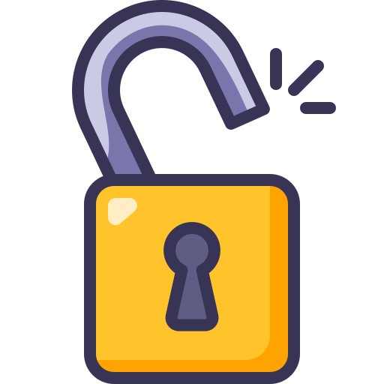
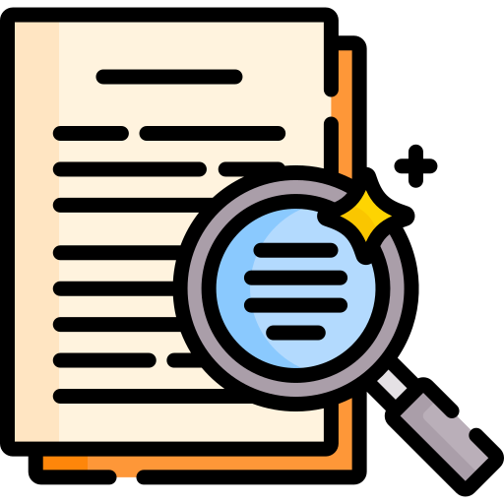
Transparency vs. Confidentiality
3c1a6fcb5ac1b3fd5982e9a29d4f5039cb90b0d7d7a7ea1d305113a8b5a86c14ea1rhdm4
SHA-256
Notes:
When it comes to adopting blockchain, companies face a significant dilemma. On one hand, blockchain's transparency is a powerful tool for accountability; on the other, it raises concerns about exposing sensitive business information. This creates a critical balance between fostering trust and protecting proprietary data.
To address these concerns, companies could use techniques like hashing. They hash a document as proof of its existence and integrity but keep the actual document private. If needed, the company can later reveal the document alongside its hash to demonstrate that it hasn’t been altered, providing transparency only when required.
This reason can still make companies hesitant about blockchain because its records can’t be changed once they’re added. In old systems, if something goes wrong and the government needs to get involved, businesses were likely to commit fraud and could tweak their documents to make things look better. But with blockchain, everything is set in stone, so there’s no chance to fix things or "cheat" if they get in trouble.

Slide 8
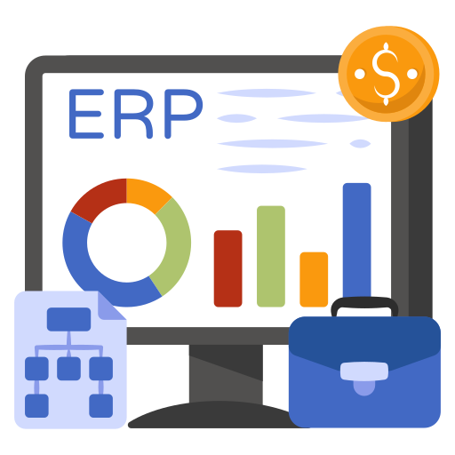
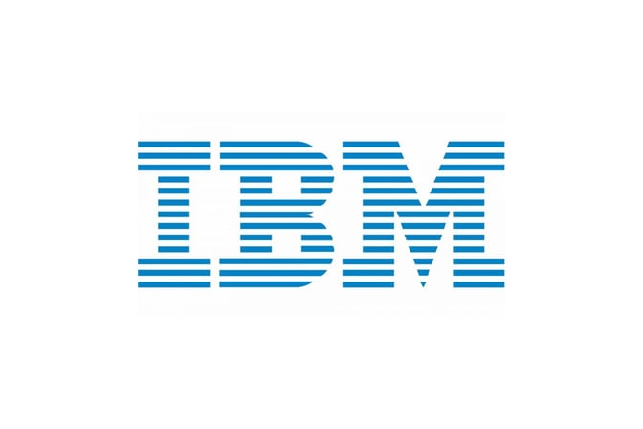
Transparency vs. Confidentiality
Automation (integration with ERPs)
Notes:
The second challenge is integrating blockchain into existing systems. Most companies rely heavily on ERP software to manage operations. Adapting legacy systems to communicate with blockchain platforms can be expensive and time-consuming. However, middleware solutions and partnerships with blockchain service providers are making this transition smoother. Companies like IBM offer tools that enable seamless integration into existing workflows.

Slide 9
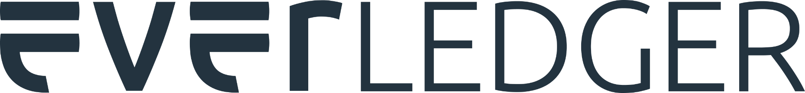

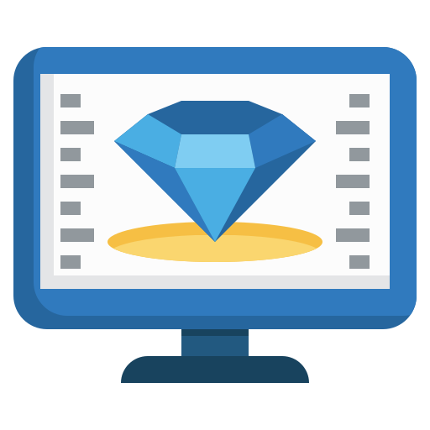
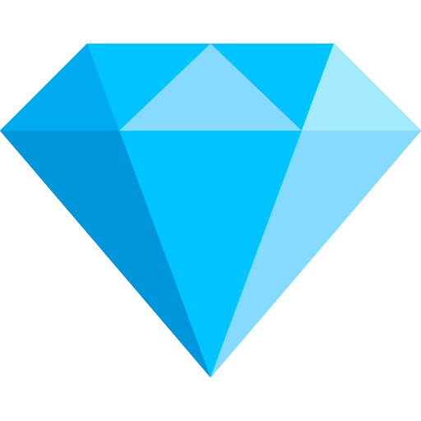
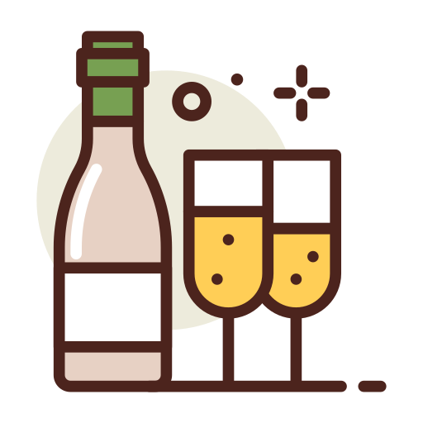
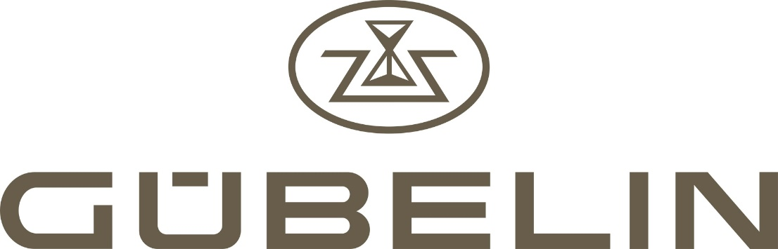
Color
Shape Value
Carat weight
Notes:
Everledger has developed a blockchain to track the movement of goods from raw materials source to sales, with its first application tracking diamonds to make sure they don’t come from conflict zones.
It uses different technologies, including blockchain, AI, IoT, and nanotechnology, to create a digital twin of every diamond: a secure and permanent digital record of an asset’s origin, characteristics, and ownership.
They collaborate with the Gemological Institute of America (GIA), to provide reports including details about the color, shape, and carat weight which ultimately informs the value of each diamond.
They also partner with Gübelin Gem Lab to deliver through the Paternity Test the exact stone’s birthplace and thanks to the blockchain then trace its journey across the supply chain.
Everledger has now moved on to various other industries where they can benefit from the secure, unalterable qualities of blockchain. For example, counterfeit wine is a growing challenge in Asian markets where as much as half of all French wine sold in China is believed to be fake. Worldwide, nearly a third of all alcoholic drinks are mislabelled, counterfeit or fake.

Slide 10
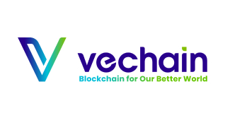
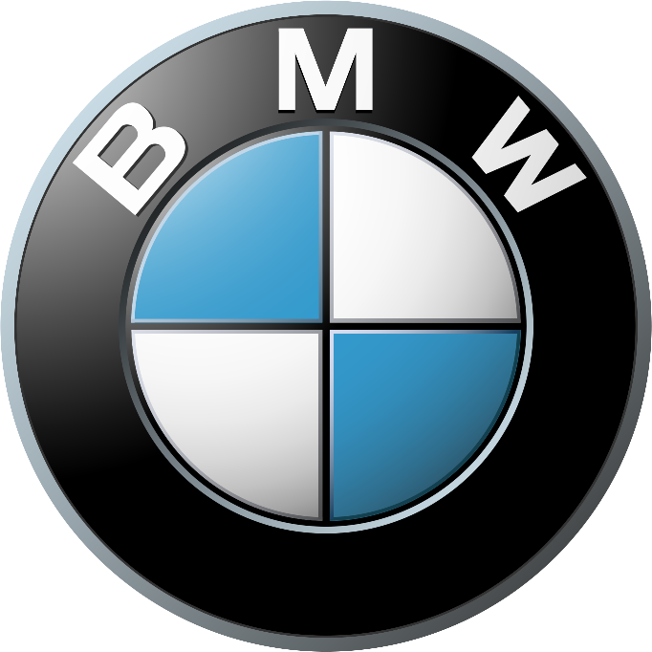
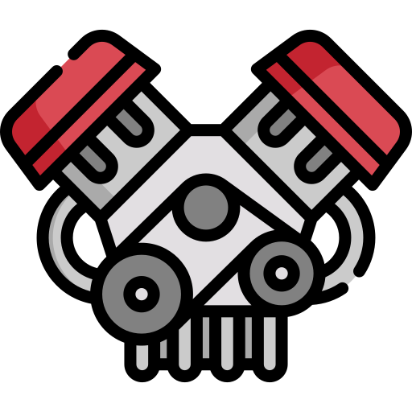
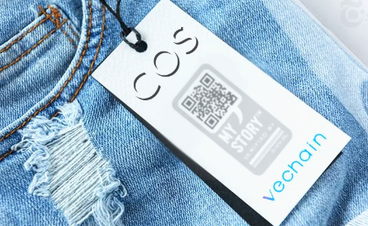
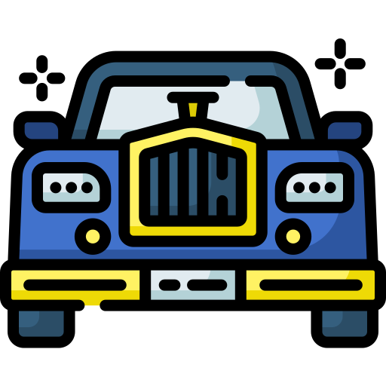
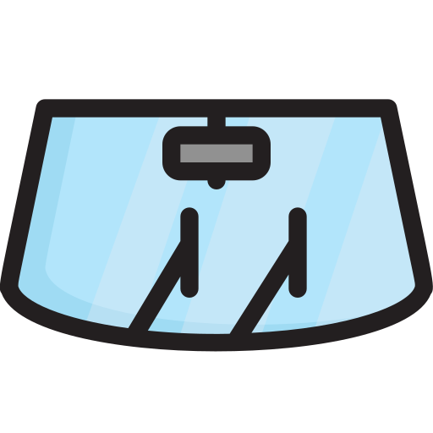
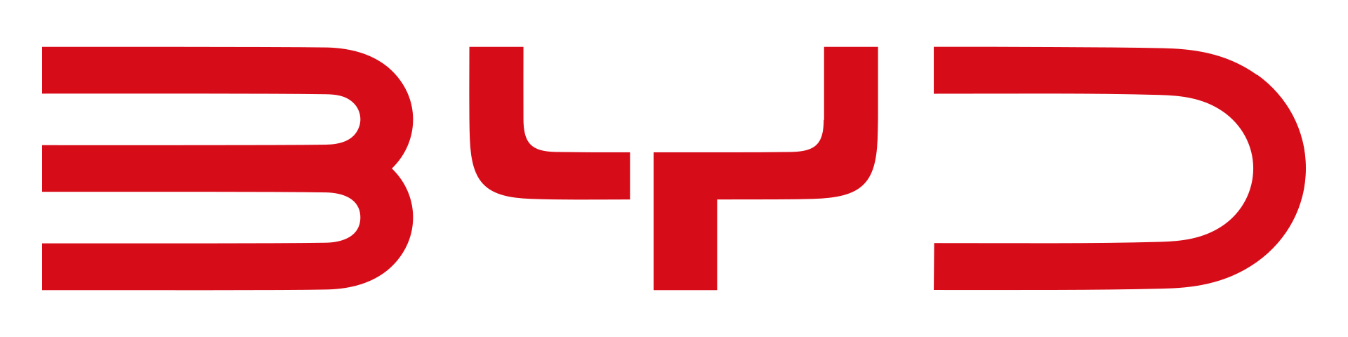
Notes:
For example, companies like BMW, Haier, and BYD benefit from VeChain’s ability to combat counterfeit parts and ensure product authenticity. In the automotive industry, VeChain allows BMW to verify that all parts, from engines to replacement components, are genuine and sourced responsibly. Similarly, manufacturers like Haier can use it to confirm the origins of materials in their appliances, strengthening customer confidence and protecting their reputation.

Slide 11

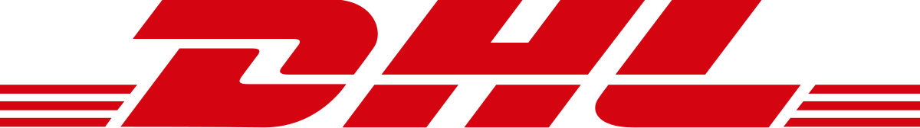



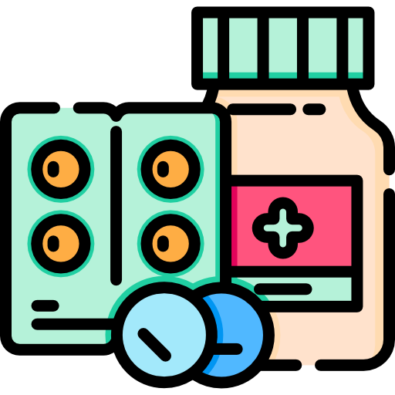
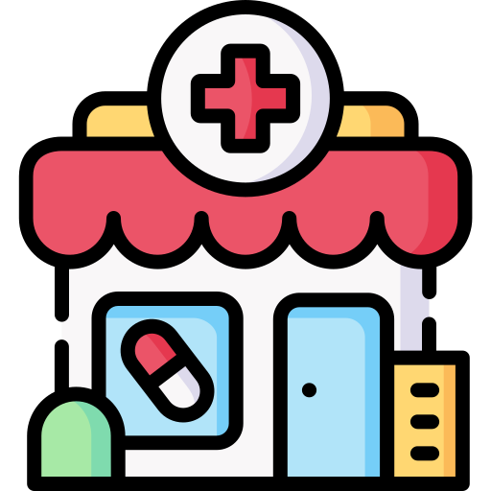
X
Notes:
DHL and Accenture created a blockchain-based serialisation prototype with nodes in six geographies to track pharmaceuticals across the supply chain.
The ledger tracking these medicines may be shared with stakeholders, including manufacturers, warehouses, distributors, pharmacies, hospitals, and doctors.
In this field it is especially useful since as many as one million lives are lost each year due to counterfeit medications, according to Interpol, and it is estimated that up to 30% of pharmaceutical products sold in emerging markets are counterfeit.
Lab-simulations show how blockchain could handle more than seven billion unique serial numbers and 1,500 transactions per second.

Slide 12
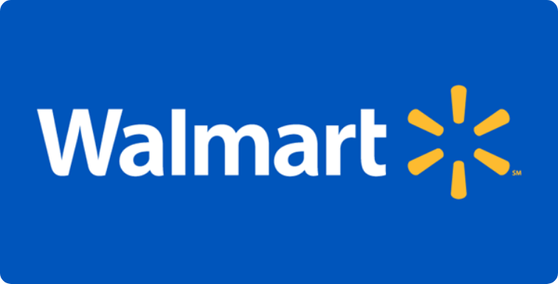
Notes:
TODO more flow in the presentation better story telling…
TODO beter bridge to other slides
TODO how is walmart using blockchain.
Thank you Carlos, I am going to talk about the expirements walmart did with the blockchain in there food supply chain. But walmart is no tech gaint.

Slide 13
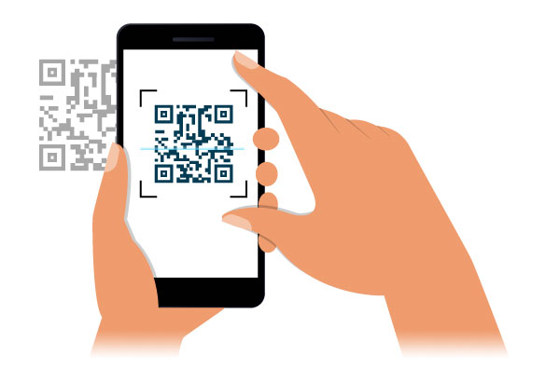
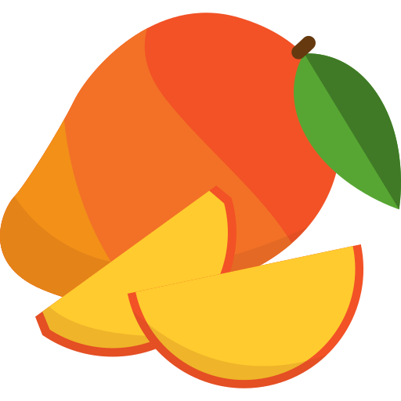
Provenance
Traceability
Transparency
Automation
Notes:
So let us go back to the complex overview of a simplified supply chain.
1. Walmart made it possible for Allice to scan a QR-code on a mango.
2. Which she could then trace back from the store she bought it in to the distributor, the supplier and al the way down to the farm.
Before blockchain this would have required a whole team and 7 days of work.
Now it only takes 2.2 seconds.
This really highlight the enhanced capabilities of blockchain offers to Provenance to the customer.

Slide 14
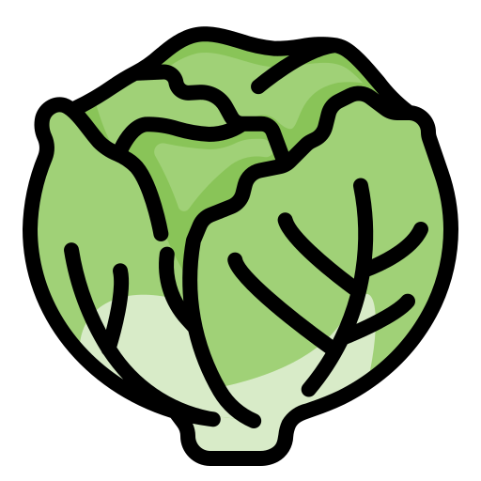
Notes:
1. So, for the next example I need you to imagen that all these farms are responsible for Romanian lettuce.
2. But there seems to be a problem 42 outbreaks of E. colli have been reported and it can be linked to romaine lettuce.
3. A logical response would be to remove all the Romanian lettuce from the stores and to stop further import until the problems are resolved.
4. But thanks to the blockchain they were able to pinpoint all outbreaks to only 2 farms. So, the other farms could still deliver their goods. And food waste / economic losses were kept to a minimum

Slide 15
Provenance
Traceability
Transparency
Automation
Notes:
1. So, for the next example I need you to imagen that all these farms are responsible for Romanian lettuce.
2. But there seems to be a problem 42 outbreaks of E. colli have been reported and it can be linked to romaine lettuce.
3. A logical response would be to remove all the Romanian lettuce from the stores and to stop further import until the problems are resolved.
4. But thanks to the blockchain they were able to pinpoint all outbreaks to only 2 farms. So, the other farms could still deliver their goods. And food waste / economic losses were kept to a minimum

Slide 16
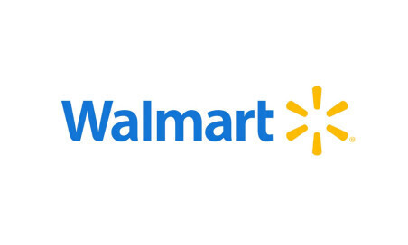
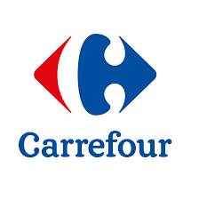
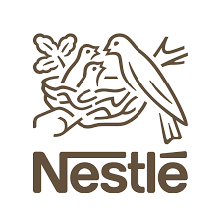
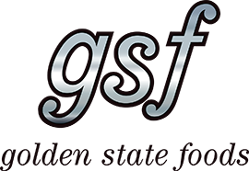
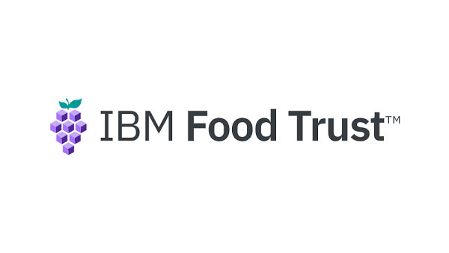
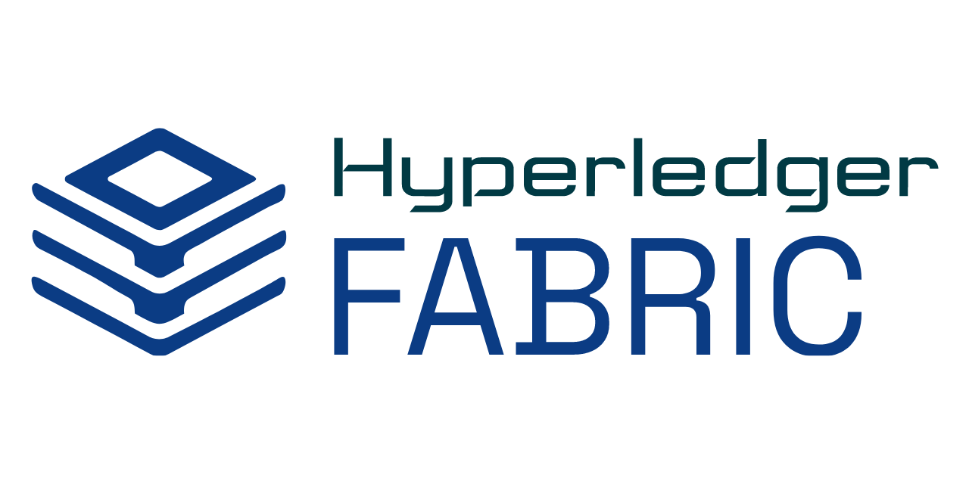

16
Notes:
So, to make use of the blockchain in their supply chain Walmart partnered with IBM. This resulted in the creation of IBM Food trust
Our peers have already covert Hyperledger fabric but as a quick refresher.
Hyperledger Fabric is an open-source framework which is maintained by the Linux foundation.
Walmart is not the only one using the IBM Food Trust. Other companies in the same industry are also using it.

Slide 17
Why use blockchain in supply chain?
need shared database?
yes
need multiple writers?
yes
trust is absent?
Not really
yes
intermediation is risky?
Not really
yes
It still is a business move
do transactions interact?
yes
Notes:
Intermediation risky? It would centralize trust When people say that transactions "interact" in a blockchain, they’re referring to how each transaction isn’t processed in isolation, but rather is influenced by and depends on the state left behind by previous transactions.

Slide 18
Any questions?

